Slide 1

ITA0329-MOBILE COMPUTING
"GSM Network Architecture & Call Flow Simulator ”
PRESENTED BY
T.Rajashree(192472393)
K.Deepthi(192472211)
GUIDED BY
Dr.Saravanan.M.S

Slide 2


INDEX
ABSTRACT
INTRODUCTION
PROBLEM STATEMENT AND PROPOSED SOLUTION
MODULES
RESULTS
CONCLUSION
REFERENCES

Slide 3
ABSTRACT
The project aims to simulate and visualize the architecture and working process of a Global System for Mobile Communications (GSM) network.
2. It explains the major GSM components, including Mobile Station (MS), Base Transceiver Station (BTS), Base Station Controller (BSC), Mobile Switching Centre (MSC), HLR, VLR, and AuC.
3. It demonstrates the step-by-step process of mobile-originated and mobile-terminated calls.
4. It illustrates call establishment, subscriber authentication, location management, call routing, and call termination.
5. It visualizes the signaling messages exchanged between different GSM network components during communication.

Slide 4
INTRODUCTION
GSM (Global System for Mobile Communications) is a digital cellular communication technology used for voice calls, SMS, and other mobile services.
GSM provides a standard method for mobile devices to communicate through cellular networks.
GSM network architecture consists of several components, including Mobile Station (MS), Base Transceiver Station (BTS), Base Station Controller (BSC), and Mobile Switching Centre (MSC).
The network also uses databases such as the Home Location Register (HLR) and Visitor Location Register (VLR) to manage subscriber information and location details.

Slide 5
PROBLEM STATEMENTS AND PROPOSED SOLUTION
Problem Statement:
Understanding GSM network architecture and its components can be difficult.
Call establishment involves multiple network elements and signaling procedures.
Incorrect subscriber authentication may prevent call connection.
Proposed Solution:
Simulate the GSM network architecture using its major components, such as BTS, BSC, MSC, HLR, and VLR.
Visualize the step-by-step call flow for incoming and outgoing calls.
Demonstrate subscriber authentication and location management.

Slide 6
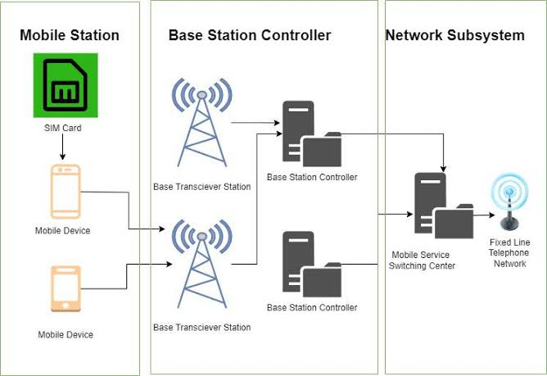
Module 1:GSM Network Architecture Simulation
Purpose: To understand the structure and components of a GSM network.
To identify the functions of MS, BTS, BSC, MSC, HLR, and VLR.
To visualize the connections and interactions between network components.
To understand subscriber registration and network connectivity.
6

Slide 7
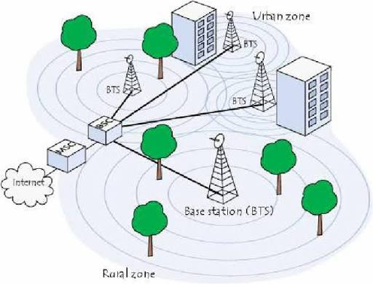
Module 2:GSM Call Flow Simulation — Purpose
Purpose:To understand the process of incoming and outgoing calls in a GSM network.
To visualize signaling messages exchanged during call establishment.
To demonstrate subscriber authentication, call routing, and channel allocation.
To identify successful calls, call failures, and call termination procedures.
7

Slide 8
RESULTS
Successfully simulated the GSM network architecture and its major components.
Visualized the connections between MS, BTS, BSC, MSC, HLR, and VLR.
Demonstrated subscriber registration and authentication procedures.
Successfully illustrated incoming and outgoing call flow processes.
Displayed signaling messages exchanged between GSM network components.
Simulated call establishment, connection status, and call termination.
Identified possible call failures due to authentication errors or network unavailability.

Slide 9
CONCLUSION
The GSM Network Architecture & Call Flow Simulator provides a clear understanding of GSM network structure and operations.
It demonstrates the functions of major components such as MS, BTS, BSC, MSC, HLR, and VLR.
It visualizes incoming and outgoing call flows step by step.
It explains subscriber authentication, call routing, signaling, and connection establishment.
It helps identify call failures and understand call termination procedures.
The graphical simulation simplifies complex mobile communication concepts.
Overall, the project serves as an effective educational tool for learning GSM network architecture and call flow operations.

Slide 10
REFERENCES
3rd Generation Partnership Project (3GPP). (2021). Digital Cellular Telecommunications System (GSM); Mobile Radio Interface Layer 3 Specification (3GPP TS 24.008). Describes GSM signaling procedures, call control, and mobility management.
- 3rd Generation Partnership Project (3GPP). (2022). Mobile Radio Interface Signaling and Core Network Protocols. Provides information about mobile network signaling and communication procedures.
European Telecommunications Standards Institute (ETSI). (2023). GSM/EDGE Radio Access Network Specifications.
- 3rd Generation Partnership Project (3GPP). (2024). Mobile Radio Interface Layer 3 Specification (3GPP TS 24.008).
Telecommunications Technology Committee (TTC). (2025). 3GPP Technical Specifications and Network Procedures. Provides technical documentation related to mobile network architecture and signaling standards.
3rd Generation Partnership Project (3GPP). (2026). 3GPP Specifications for Mobile Communication Networks.

Slide 11


